Slide 1
Analysis on Indian General Elections-2019
Course Code : INT 217
Name : B. Lakshmi Ajeeth Kumar
Registration No.: 11700845

Slide 2
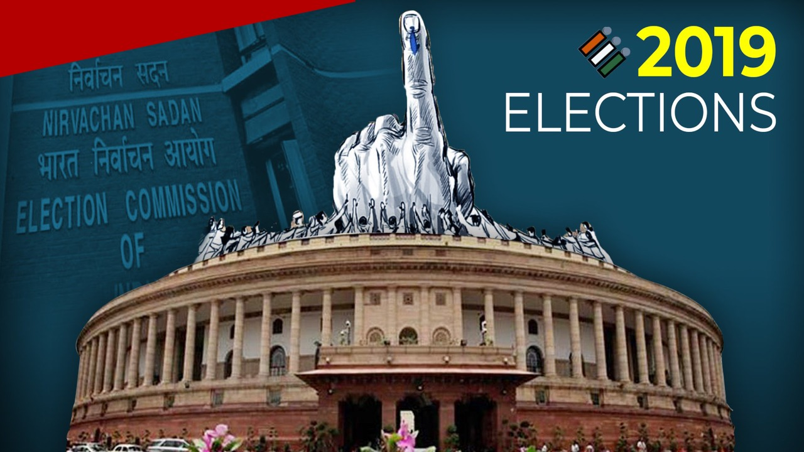
Introduction :-
An election is a process in which people vote to choose a person or group of people to hold an official position. In this process winning and losing were part of it but what you do after losing is the important aspect of it. To know the reason for your defeat is a detailed analysis of the elections done is required.

Slide 3
objectives
Objectives involved: -
To analysis the strongest party among BJP and INC in each state showing the results of number of votes they got in that state and for easy understating a graph is included.
To analysis the strongest candidate in country on the bases of percentage of votes one got. And display the results with an easily understandable graph.
To analysis the strongest party in North India on the bases on the number of seats won by each party. And for easy understating a graph is included.
To analysis the strongest party in South India on the bases on the number of seats won by each party. And for easy understating a graph is included.
To have the detailed of a particular state and have the winning result of each constitution in the state by showing which party won and displaying the votes they won. And display the comparison graph.

Slide 4
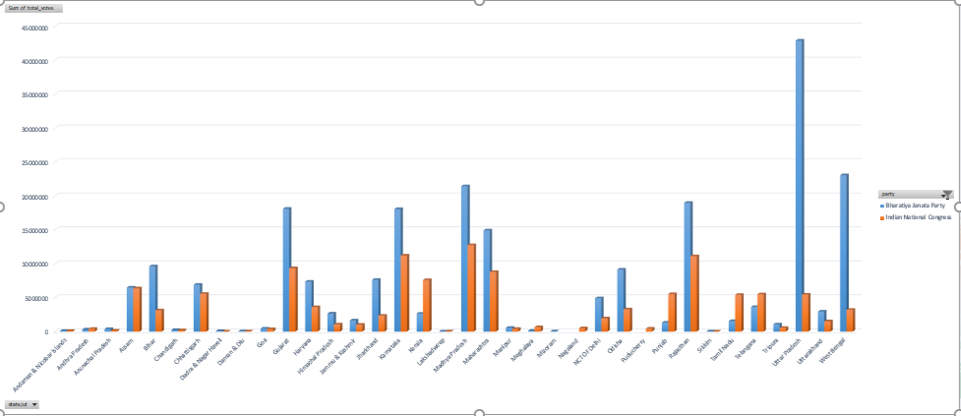
To analysis the strongest party among BJP and INC in each state showing the results of number of votes they got in that state and for easy understating a graph is included

Slide 5
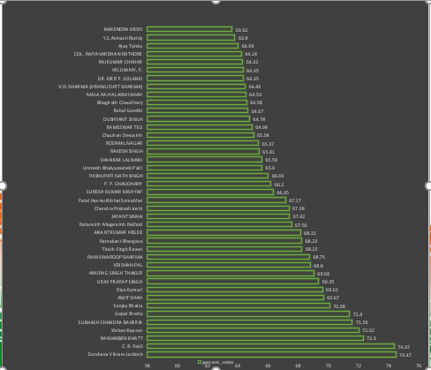
To analysis the strongest candidate in country on the bases of percentage of votes one got. And display the results with an easily understandable graph

Slide 6
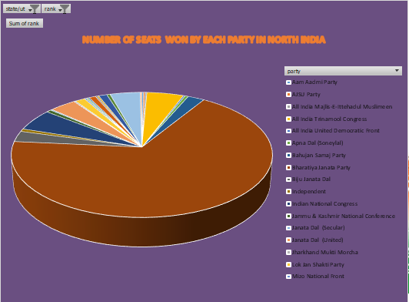
To analysis the strongest party in North India on the bases on the number of seats won by each party. And for easy understating a graph is included.

Slide 7
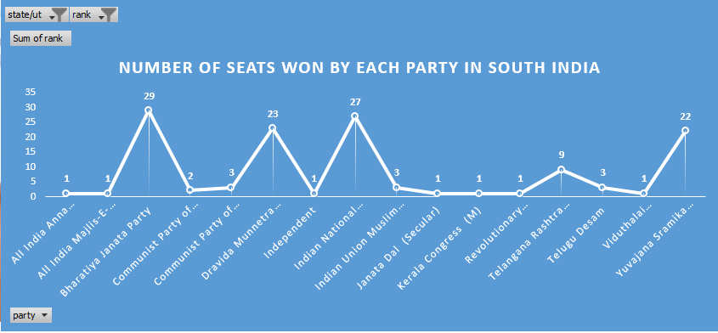
To analysis the strongest party in South India on the bases on the number of seats won by each party. And for easy understating a graph is included

Slide 8
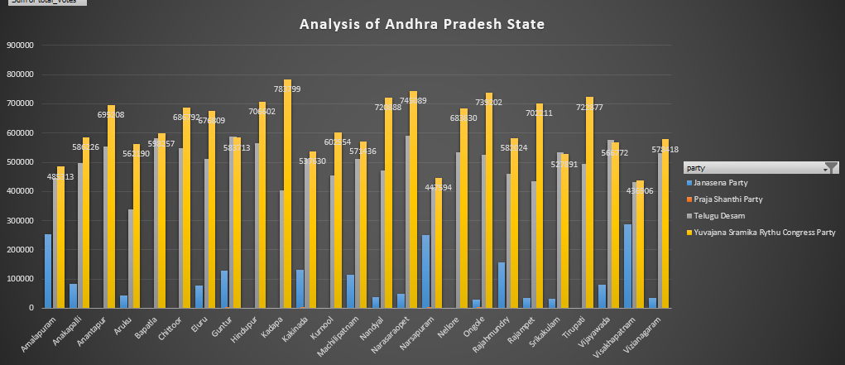
To have the detailed of a particular state and have the winning result of each constitution in the state by showing which party won and displaying the votes they won. And display the comparison graph

